Slide 1
Note taking
SOS: Strategies for Optimal Studying

Slide 2
Note taking Strategies
First you must listen.
Anticipate what is coming next.
Focus on listening to what is being said.
Taking notes keeps your mind active.
Resist distractions.
Involve yourself by thinking of examples as the speaker talks.
Listen closely to introductory and closing remarks
Pay attention to speaker cues…voice, physical motions, rate of speech

Slide 3
More Strategies
Note any material that is repeated
Summarize the information to yourself
Develop a personal shorthand…create a code
w/o without
b/c because
w/ with
+ and
govt government
b/f before
imp important
cont continue
rt right

Slide 4
Note taking from Lectures
Do you ever assume you don’t need to write anything down because you “heard it”??
Within 2 weeks you will forget 80% of what you heard.
Within 4 weeks you will remember only 5 % of what you heard.

Slide 5
Before class
Review the notes from the day before
Make sure you have paper, text, pens/pencils, handouts
Plan on listening 80% of the time and writing 20% of the time
Write the date at the top of your paper for notes.
Leave spaces between the lines so that you can add information later.

Slide 6
During class
Write main idea (These points are what your teacher emphasizes and repeats.)
Write important details

Slide 7
Watch for signals of importance
Copy specific definitions the teacher writes on the board or overhead.
Always write definitions and listings
The 4 steps in this process…
7 characteristics are…
The 2 causes are…
These 4 reasons are…

Slide 8
Signals of Importance
Listen for important remarks…
And don’t forget…
This is an important reason…
Pay special attention to….
The basic idea is ….
….and I’ll keep coming back to the idea that…

Slide 9
Signals of Importance
Teacher’s physical gestures
Pointing
Listing with fingers
Facial expressions
Stepping forward
Tapping on the desk or board…

Slide 10
Signals of Importance
Listen to the teacher’s voice and note:
Changes in speed
Changes in volume
Changes in pitch
Teachers often state the most important ideas during the last 5 minutes of a class!!!

Slide 11
Notetaking Strategies
Cornell Note taking
Two Column Method
Outlining
Mapping Method
Sentence Method

Slide 12
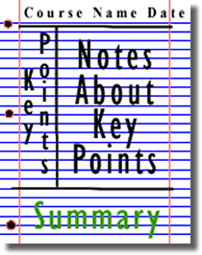
Cornell Note taking

Slide 13
Two Column Method
Name Date
Key Words | Description

Slide 14
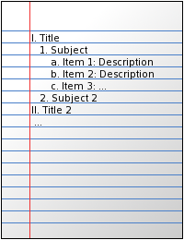
Outlining

Slide 15
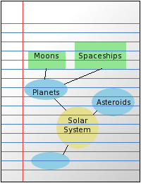
Mapping Method

Slide 16
Sentence Method
Write sentences on every other line.

Slide 17
Which one makes sense to you?
Try different methods and figure out which will work the best for you
You may need to use different note taking styles depending on the subject or the teacher

